Slide 1
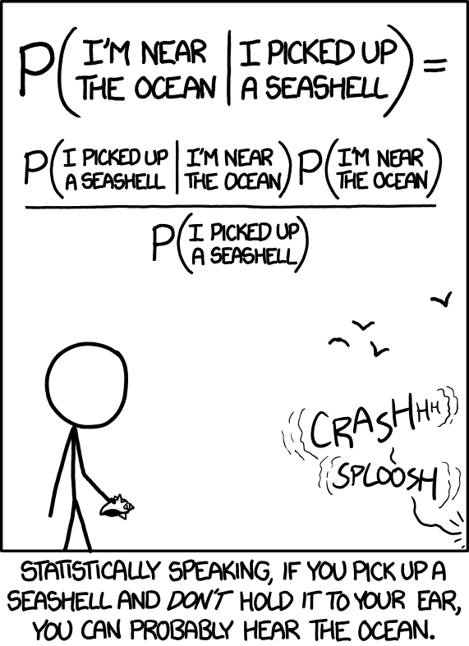
The basics of Bayes decision theory
Gosztolya Gábor
University of Szeged
Institute of Informatics
2023 / Mar / 02

Slide 2
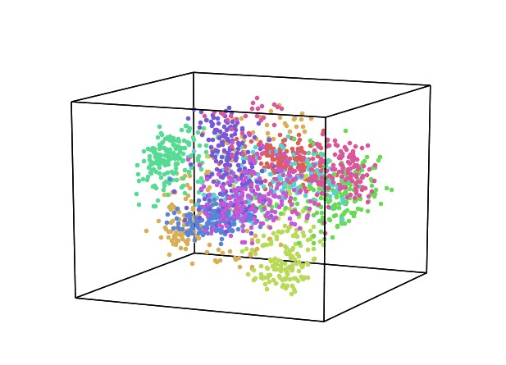
Statistical pattern recognition
The most popular approach to pattern classification
It has a firm background in mathematics (statistics)
It offers practically applicable solutions
It seeks to solve the classification task
Objects to be classified → feature vector x
Goal: to map each object (feature vector) into one of the classes C = { c₁, .., c_{M} }

Slide 3
Statistical pattern recognition
Background in statistics (probability theory): we will estimate the joint (conditional) probability of X and C
Bayes formula:
P(c_{i}|x) : the a posteriori probability of class c_{i}
P(x|c_{i}) : the class-conditional distribution of the x feature vectors
P(c_{i}) : the a priori distribution of the c_{i} class
P(x) : it will not be important for the optimal classification (see later)

Slide 4
The Bayes decision rule
We seek to minimize: the number (rate) of misclassifications on the long run
Formalization: Introduce the 0-1 loss function: λ_{i}(c_{k},x)
Bayes’ decision rule: the long-run rate of misclassifications will be minimal if for each input vector x we chose the class c_{i} for which P(c_{i} |x) is maximal
(“Maximum A Posteriori decision”, “MAP-decision” for short)
k: correct class
i: selected class

Slide 5
The Bayes decision rule #2
Bayes’ decision rule: the long-run rate of misclassifications will be minimal if for each input vector x we chose the class c_{i} for which P(c_{i} |x) is maximal
Proof: we can formalize the error as the expected value of λ_{i}(c_{k},x). We also call it the risk of choosing class c_{i}:
This will be minimal for i if P(c_{i} |x) is maximal

Slide 6
The Bayes decision rule #3
To calculate the global risk over all the feature space X, we have to calculate
Of course, if we minimize the risk for all x values (i.e. we make an optimal decision for all x), then the global risk will also be minimized at the same time

Slide 7
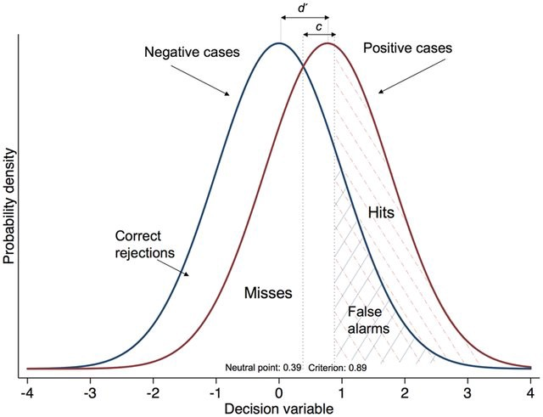
The Bayes decision rule #4
The Bayes’ decision rule is a special case of what we called the indirect or decision theoretic approach earlier:
For each class c_{i} we create the discriminant function g_{i}(x)
We classify a given test point x by selecting the class for which g_{i}(x) is maximal
This approach may also be used with other discriminant functions, but optimality is guaranteed only for the g_{i}(x)=P(c_{i}|x) case
So: we should estimate P(c_{i}|x) from a finite training set as accurately as possible

Slide 8
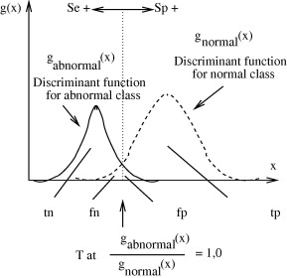
Discriminant functions and decision surfaces
The discriminant functions together with the decision rules indirectly define decision surfaces
Example for two classes (a and b):
g_{i}(x)
g_{a}(x)
g_{b}(x)
a
b

Slide 9
Diszkriminánsfüggvények és döntési felületek #2
Note: certain transformations modify the discriminant functions, but not the decision boundary.
E.g the following yield the same boundary:
…since Bayes’ decision rule refers simply to the highest value of the discrimination functions, irrelevantly of the scale!
(…but might technically be easier or more difficult to handle; e.g. using log-prob because of numeric representations…)

Slide 10
The error of the Bayes’ decision
In the case of Bayes decision, the probability of making an incorrect classification: Bayesian error
Visualized in the dashed region on this figure
Given the actual distributions, this is the smallest possible error
But it might not be small on an absolute scale!
It can only be reduced by finding better features – i.e. by reducing the overlap of the distributions of the classes!
P(x,ω_{i})
c₁
c₂
R₁
R₂

Slide 11
The error of the Bayes’ decision
Shifting the boundary would only increase the error!
P(x,ω_{i})
P(x,ω_{i})
c₁
c₂
c₁
c₂
R₁
R₂
R₁
R₂

Slide 12
Probability estimation with discrete features
How can we estimate the distribution of discrete features? By simple counting:
P(Joint_pain=No | Infuenza=Yes) ≈ 1/3
It works fine for few possible values and lots of examples…
Many possible values and/or few examples → unreliable estimates
It can be handled, but… (“garbage in, garbage out”)
Fever | Joint_pain | Cough | Influenza
38.2 | Yes | No | Yes
36.7 | Yes | Dry | No
41.2 | No | Wet | Yes
38.5 | Yes | Dry | Yes
37.2 | No | No | No

Slide 13
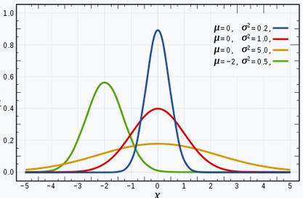
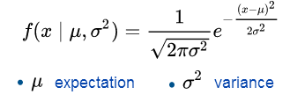
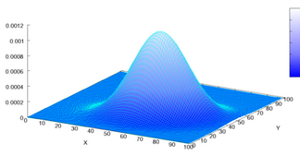
Probability estimation for continuous features
In the case of a continuous feature set we usually assume that the distribution can be described by some parametric curve
Using the normal (Gaussian) distribution is the most common solution
Univariate Gaussian distribution:
Multivariate Gaussian distribution:

Slide 14
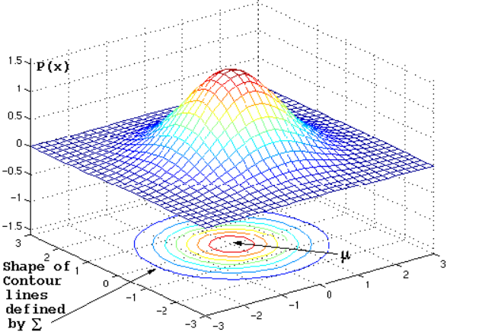
Covariance matrix - Examples
We will visualize 2D densities using their contour lines (…too…)

Slide 15
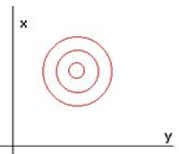
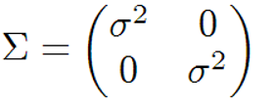
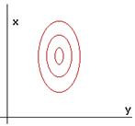
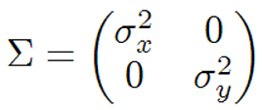
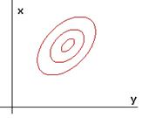
Covariance matrix - Examples
Diagonal covariance matrix with the same variance for both features
The contour lines are circles
Diagonal covariance matrix with different variances
Allows stretching the circles along the axes
Non-diagonal covariance matrix
Allows both stretching and rotation

Slide 16
Decision boundaries for normal distributions
For simplicity, let’s assume that we have only two classes
Let’s also assume that they can be described by normal distributions
The decision rule requires P(c_{i}|x) = p(x|c_{i}) · P(c_{i}) / p(x)
…and we choose the class for which this is maximal
Notice that, for a given x, p(x) is constant, so it does not affect the maximization for i
The same holds for any monotonic transformation
…like taking the logarithm

Slide 17
Decision boundaries for normal distributions
(Recap: P(c_{i}|x) = p(x|c_{i}) · P(c_{i}) / p(x) )
So we can use the following discriminant function: g_{i}(x) = ln(p(x|c_{i}) · P(c_{i}))
where
Putting it all together gives

Slide 18
Special case #1
Let’s assume that Σ_{i} = σ²I (identity matrix) for both classes
“diagonal covariance matrix with the same variance”
And this variance is the same for all (both) classes!
Then
We can discard:
det Σ_{i}, as it is the same for both classes, it does not influence the decision
-d/2 ln 2π is a constant, it does not influence the decision either

Slide 19
Special case #1
The remaining components reduce to:
As σ² is independent of i, the discriminant function is basically the Euclidean distance to the mean vector of the classes:
The role of P(c_{i}) will be discussed later

Slide 20
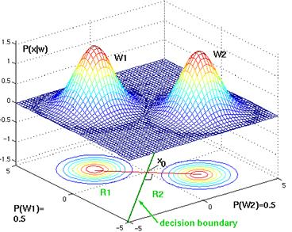
Special case #1
How does the distributions and the decision surface look like in 2D?
Decomposing the discriminant functions, we get:
As x^{T}x is independent of I, we can discard it:

Slide 21
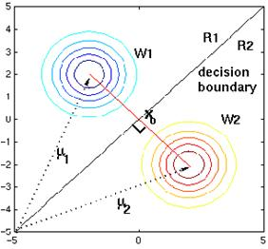
Special case #1
This is a linear function of x
Thus
the discriminant functions are hyperplanes,
The decision boundary is a straight line.
We will discuss the role of P(c_{i}) later (still)

Slide 22
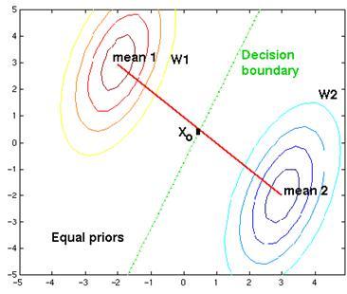
Special case #2
Σ_{i} = Σ, so the classes have the same (but arbitrary) covariance matrix
Discarding the constants…
…the discriminant function is reduced to:
The first term is known as the Mahalanobis distance of x and μ_{i}

Slide 23
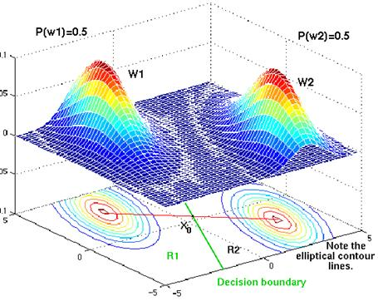
Special case #2
Decomposing the formula:
We can drop x^{T}Σ⁻¹x as it is independent of i
So we get:
This is again linear in x
The discriminant functions are hyperplanes
The decision boundary is a straight a line (in 2D)

Slide 24
General case
The covariance matrices are different, and may take any form
In this case we cannot reduce the discriminant function, it remains quadratic in x
The decision boundary may take the shape of a conic section (line, circle, ellipsis, parabola or hyperbola).
Recommended reading: https://www.byclb.com/TR/Tutorials/neural_networks/ch4_1.htm

Slide 25
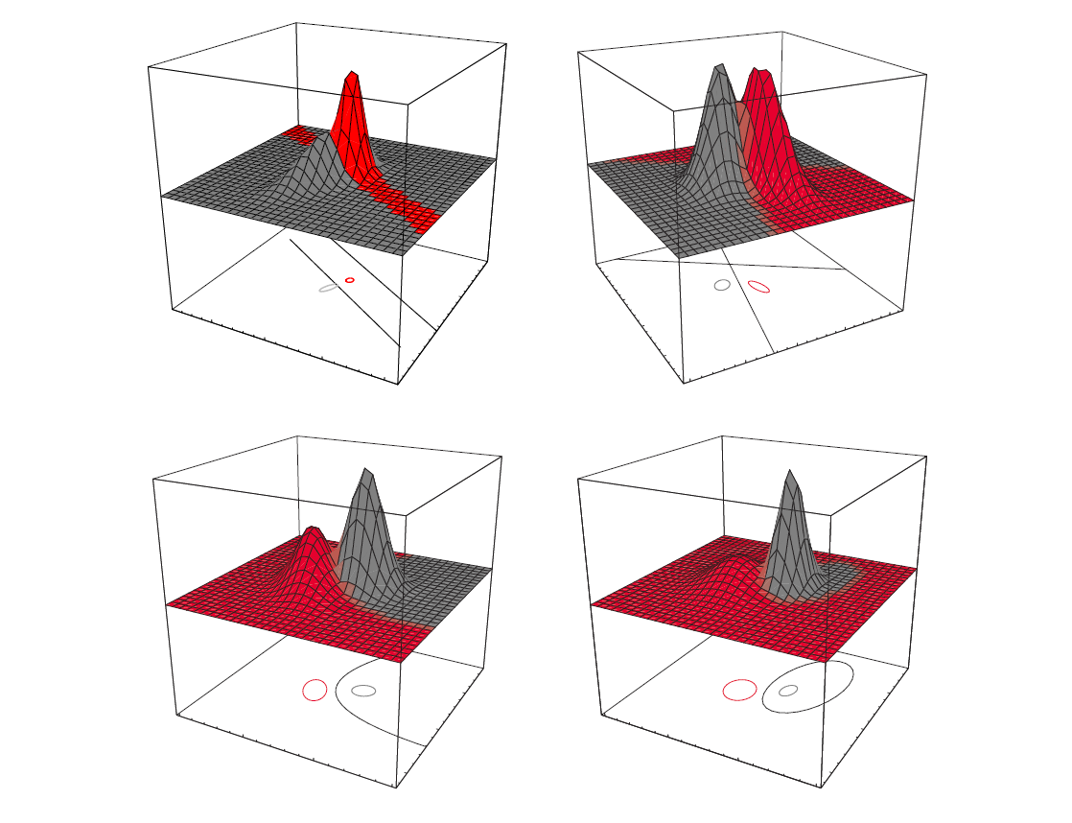
General case – examples #1

Slide 26
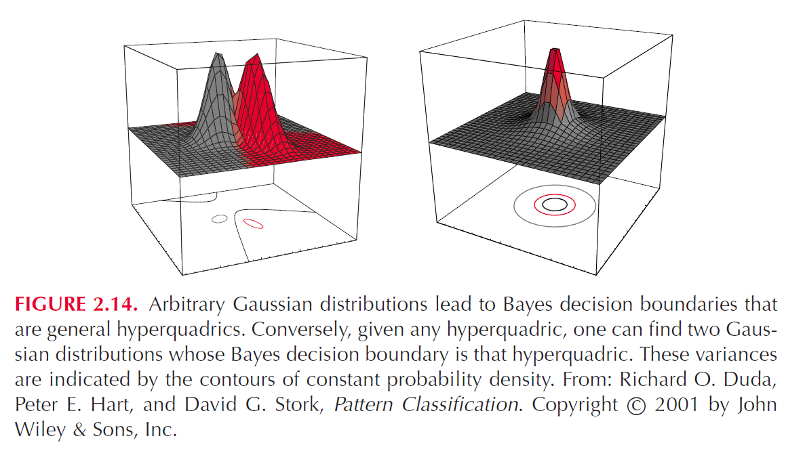
General case – examples #2

Slide 27
The effect of the class priors
How does the decision boundary change if we change P(c_{i})?
g₁(x) = p(x|c₁) · P(c₁) ; g₂(x) = p(x|c₂) · P(c₂)
Don’t forget that P(c₁) + P(c₂) = 1
Changing (the ratio of) P(c₁) and P(c₂) equals to multiplying the disciminant functions by a constant
This shifts the decision boundary towards the less frequent class
P(c₁) =0.5 and P(c₂) = 0.5 P(c₁) = 0.1 and P(c₂) = 0.9

Slide 28
The sources of errors in statistical pattern recognition
In summary, creating a classifier by the statistical pattern recognition approach consists of 3 main steps:
Select a suitable feature set
Select a parametric model that we will use to describe the distribution of the data (when the features are continuous)
Based on a finite set of training data, estimate the parameter values of the model
The errors of these 3 steps all contribute to the final error of the classifier
Error = Bayes error + model error + estimation error
What can we do about it?

Slide 29
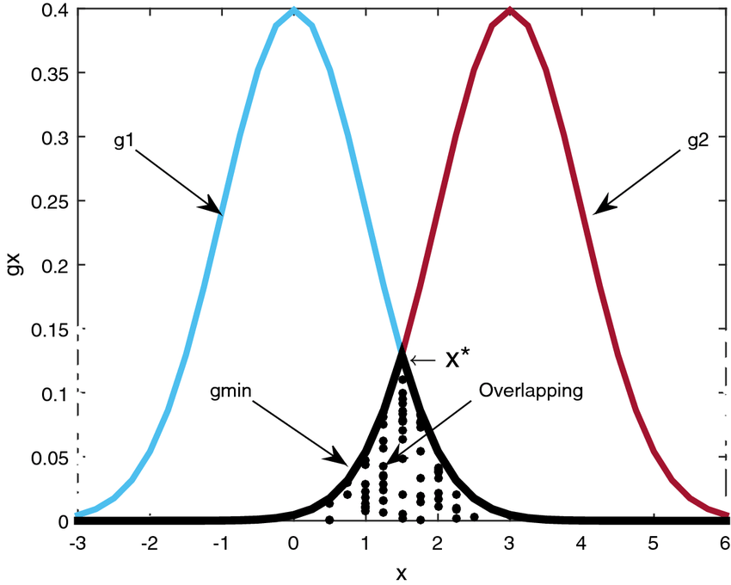
Handling the errors
Bayes error: If the features do not fully separate the classes
The class distributions will overlap
This will be present even if we perfectly know the distributions
The only way to decrease the Bayes error is to select other features (which describe the (difference of the) given classes better)

Slide 30
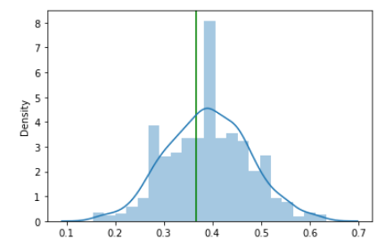
Handling the errors
Model error: If the chosen (modelled) statistical distribution does not fit the data enough
For mathematical tractability, we must assume something about the shape of the distribution (e.g. it is a Gaussian distribution)
The data rarely has this shape, there will be a mismatch – this is the error of the model choice
This error can be decreased by choosing a better model

Slide 31
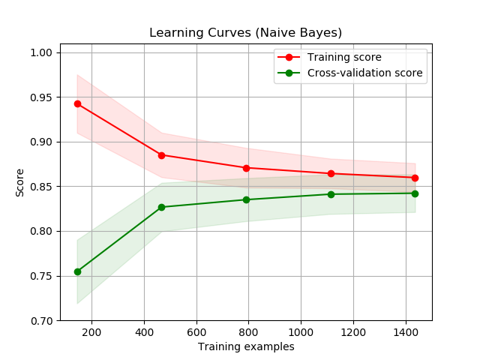
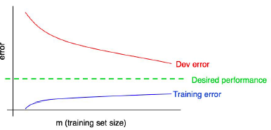
Handling the errors
Estimation error: we estimate the model parameters from the training data via some training algorithm
This error can be decreased by using more training data and/or by refining the training algorithm

Slide 32
The naïve Bayes classifier
We examined how the decision surfaces look like for Gaussian distributions with given parameters
What’s next? We will assume that the samples in each class have a Gaussian distribution (true or not, see later…)
And we will estimate the distribution parameters from the data
Our class distributions are of the form

Slide 33
The naïve Bayes classifier
(recap) Our class distributions are of the form
So the parameters we have to estimate are μ_{i} and Σ_{i} for each class c_{i}
x is a vector → we have to estimate the parameters of a multivariate distribution!
As it is not an easy task, we start with a simplified model
This will be the naïve Bayes classifier

Slide 34
The naïve Bayes assumption
The naïve Bayes model assumes that the features are conditionally independent, so we can write
With this assumption we have to estimate d 1-variable distributions instead of 1 d-variable distribution
This is mathematically and technically easier
Advantage #1

Slide 35
The naïve Bayes assumption #2
For example we can use an univariate Gaussian distribution for a continuous feature:
…where we can estimate μ by the empirical mean of the data items:
…and σ² by the empirical variance of the data over μ (where D is the number of training examples):
See the “diagonal covariance matrix with different variances” case
We will prove later that these formulas are correct

Slide 36
The naïve Bayes assumption #3
A big advantage (#2) of the naïve Bayes model is that can easily handle the case when the feature vector consists of both discrete and continuous features!
For the discrete features we can apply a simple counting-based estimation, remember the example:
P(Joint_pain=No | Infuenza=Yes) ≈ 1/3
Fever | Joint_pain | Cough | Influenza
38.2 | Yes | No | Yes
36.7 | Yes | Dry | No
41.2 | No | Wet | Yes
38.5 | Yes | Dry | Yes
37.2 | No | No | No

Slide 37
The naïve Bayes assumption #4
The third advantage of the naïve Bayes approach is that it is a very efficient tool against the curse of dimensionality
It is very useful if we have few training samples and/or a lot of features
Example: text classification with “bag of words” features
e-mails → spam/non-spam, articles → topic, etc.
We have to find some features that represent the text
“bag of words” representation: the number of the occurrence of each possible word in the text
Of course, the order of words is also important, but this is a very simple representation…

Slide 38
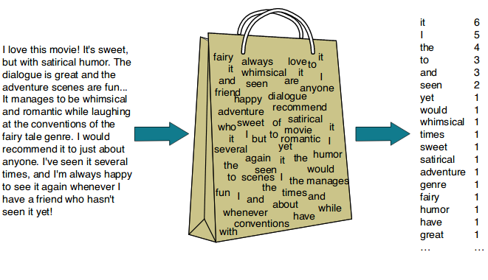
Example: bag-of-words representation
This results if a HUGE feature space (100k+ features)
For this task, any method other than Naïve Bayes is pretty difficult to use due to data sparsity (even if we have a lot of training data)

Slide 39
The naïve Bayes model - Summary
Advantages:
Mathematical simplicity, easy implementation
It can handle the mixture of continuous and discrete features
Very efficient in handling sparse data (large feature space, few samples)
Disadvantage:
Assuming feature independency is incorrect in most cases
In spite of this, the naïve Bayes approach is very popular and works surprisingly efficiently for many classification tasks

